Slide 1
VMAT Quiz
11/11/19

Slide 2




Q1
Explain these two equations. What two factors are being optimized?

Slide 3
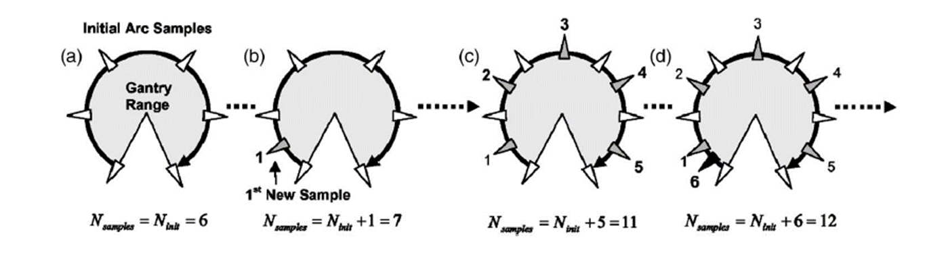
Q2
Describe the process of progressive sampling.

Slide 4
Q3
Describe the advantages and disadvantages of VMAT as compared to standard IMRT or 3D.

Slide 5
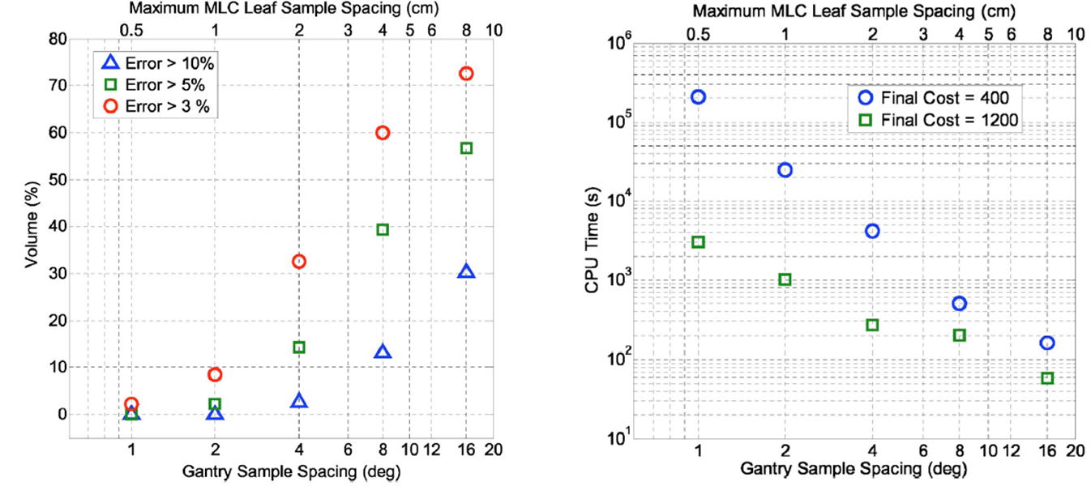
Q4
Describe these figures.

